Slide 1


Victor Diirr
November 6th, 2024

Slide 2

Outline
Executive Summary
Introduction
Methodology
Results
Conclusion
Appendix

Slide 3
Executive Summary
Summary of methodologies
- Data Collection API
- Data Collection with Web Scraping
- Data Wrangling
- Exploratory Data Analysis with Data Visualization
- Exploratory Data Analysis with SQL
- Interactive Visual Analytics with Folium
- Predictive Analysis with Machine Learning
Summary of all results
- Exploratory Data Analysis
- Interactive Analytics in Screenshots
- Predictive Analytics Results

Slide 4
Introduction
Project background and context
SpaceX advertises Falcon 9 rocket launches on its website at a cost of $62 million. In comparison, other providers charge upwards of $165 million per launch. Much of this savings is due to SpaceX’s ability to reuse the first stage of the rocket. Therefore, by being able to predict whether the first stage will land successfully, we can determine the true cost of a launch. This information can be used if an alternate company wants to bid against SpaceX for a rocket launch.
Problems you want to find answers
- What factors determine if the rocket will land successfully?
- The interaction amongst various features that determine the success rate of a successful landing.
- What operating conditions needs to be fulfilled to ensure a successful landing program.

Slide 5

Section 1

Slide 6
Methodology
Executive Summary
Data collection methodology:
- Data was gathered using the SpaceX API, supplemented by web scraping for additional details.
Perform data wrangling
- The data processing involved cleaning and transforming the raw data, removing inconsistencies, and formatting the information appropriately for analysis.
Perform exploratory data analysis (EDA) using visualization and SQL
Perform interactive visual analytics using Folium and Plotly Dash

Slide 7
Methodology
Executive Summary
Perform interactive visual analytics using Folium and Plotly Dash
Perform predictive analysis using classification models
- Building Classification Models: Constructing models using various algorithms suitable for classification tasks.
- Tuning Models: Optimizing model performance by adjusting hyperparameters to achieve the best results.
- Evaluating Models: Assessing model effectiveness through metrics such as accuracy, precision, recall, and F1-score to ensure robust predictions for future landing outcomes.

Slide 8
Data Collection
Request to the SpaceX API
- Use a GET request to gather data from the SpaceX API.
- To ensure consistent JSON results for this project, was utilized a static response object.
- Decode the response content as JSON using .json() and convert it into a Pandas DataFrame using .json_normalize().
Data Cleaning
- Inspect the obtained DataFrame for missing values.
- Replace missing values as needed to maintain data integrity.
Web Scraping Falcon 9 Launch Records with BeautifulSoup
- Extract the HTML table of Falcon 9 launch records from Wikipedia.
- Parse the table and convert it into a Pandas DataFrame.

Slide 9
Data Collection – SpaceX API
Use GET request to retrieve data
Use Json on a static response object and convert into pandas DataFrame
Check the data for missing values, replace than to maintain integrity
GitHub link:
GitHub - Data Collection
Use GET request to retrieve data
Decode the response content as JSON
Data Cleaning
Convert it into a Pandas DataFrame

Slide 10
Data Collection - Scraping
Extract HTML table records of Falcon 9 Launch,
Parse the table and convert into a Data Frame
GitHub link:
GitHub - Data Scraping
Extract the HTML table records from Wikipedia
Create a BeautifulSoup
object from HTML
table
Create a Pandas DataFrame
Parse the table and convert it into a Pandas DataFrame

Slide 11
Data Wrangling
EDA
Exploratory Data Analysis (EDA)
Summary Launch and Orbit Analysis
Label Creation and Export
GitHub link:
GitHub - Data Wrangling
Summary
Landing Outcome Label

Slide 12
EDA with Data Visualization
The data was explored by visualizing the relationship between:
- Flight Number and Launch Site
- Payload Mass and Launch Site
- success rate of each orbit type
- FlightNumber and Orbit type
- Payload Mass and Orbit type
- Visualize the launch success yearly trend
GitHub link:
GitHub - Data Visualization

Slide 13
EDA with SQL
The following SQL queries were performed:
- Display the names of the unique launch sites in the space mission
- Display 5 records where launch sites begin with the string 'CCA’
- Display the total payload mass carried by boosters launched by NASA (CRS)
- Display average payload mass carried by booster version F9 v1.1
- List the date when the first successful landing outcome in ground pad was achieved.
- List the names of the boosters which have success in drone ship and have payload mass greater than 4000 but less than 6000
- List the total number of successful and failure mission outcomes
- List the names of the booster versions which have carried the maximum payload mass. Use a subquery
- List the records which will display the month names, failure landing outcomes in drone ship ,booster versions, launch site for the months in year 2015.
- Rank the count of landing outcomes (such as Failure (drone ship) or Success (ground pad)) between the date 2010-06-04 and 2017-03-20, in descending order.
GitHub link:
GitHub - SQL

Slide 14
Build an Interactive Map with Folium
Mark all launch sites on a map
Mark the success/failed launches for each site on the map
Calculate the distances between a launch site to its proximities
GitHub link:
GitHub - Interactive Map with Folium

Slide 15
Build a Dashboard with Plotly Dash
Add a Launch Site Drop-down Input Component
Add a callback function to render success-pie-chart based on selected site dropdown
Add a Range Slider to Select Payload
Add a callback function to render the success-payload-scatter-chart scatter plot
GitHub link:
GitHub - Dashboard with Ploty Dash

Slide 16
Predictive Analysis (Classification)
Perform exploratory Data Analysis and determine Training Labels
Create a column for the class
Standardize the data
Split into training data and test data
Find best Hyperparameter for SVM, Classification Trees and Logistic Regression
Find the method performs best using test data
GitHub link:
GitHub - Predictive Analysys

Slide 17
Results
Exploratory data analysis results
Interactive analytics demo in screenshots
Predictive analysis results

Slide 18

Section 2

Slide 19
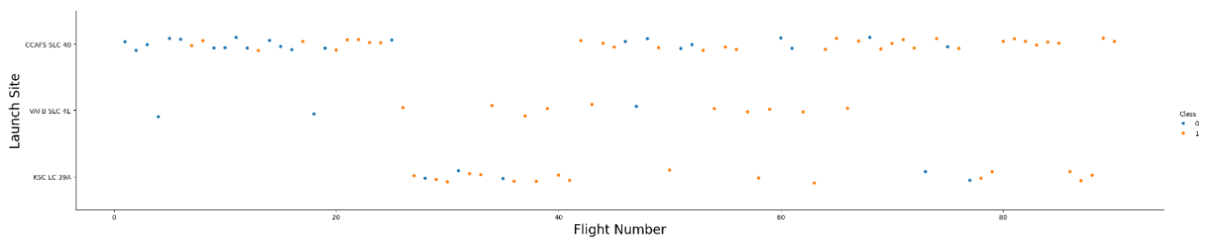
Flight Number vs. Launch Site
The larger the flight amount at a launch site, the greater the success rate at a launch site.

Slide 20
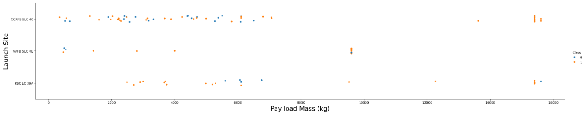
Payload vs. Launch Site
The greater the payload mass for launch site CCAFS SLC 40 the higher the success rate for the rocket.

Slide 21
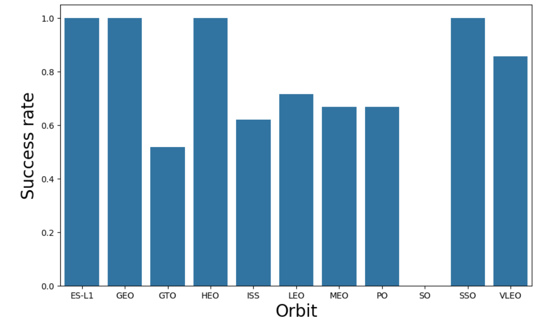
Success Rate vs. Orbit Type
From the plot, we can see that ES-L1, GEO, HEO and SSO had the most success rate

Slide 22
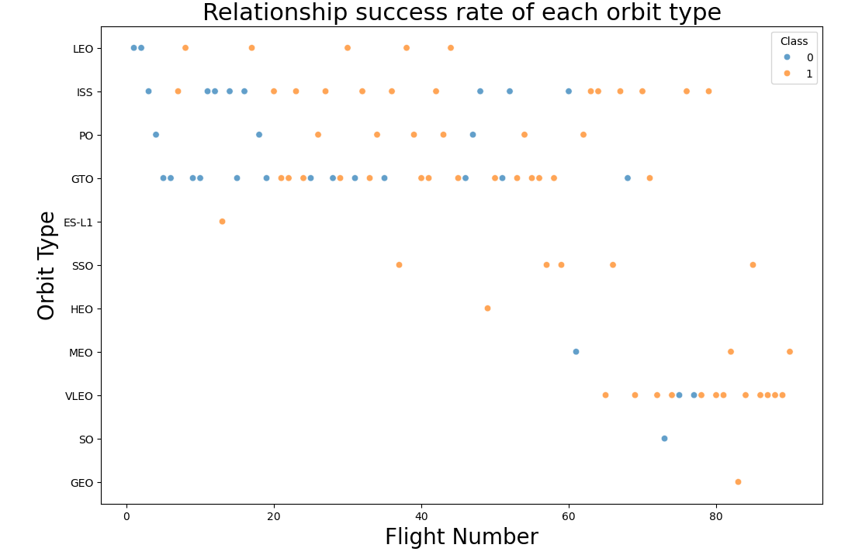
Flight Number vs. Orbit Type
We can see if there is any relationship between Flight Number and Orbit type.
GTO appears to be no relationship between Flight Number and Orbit type

Slide 23
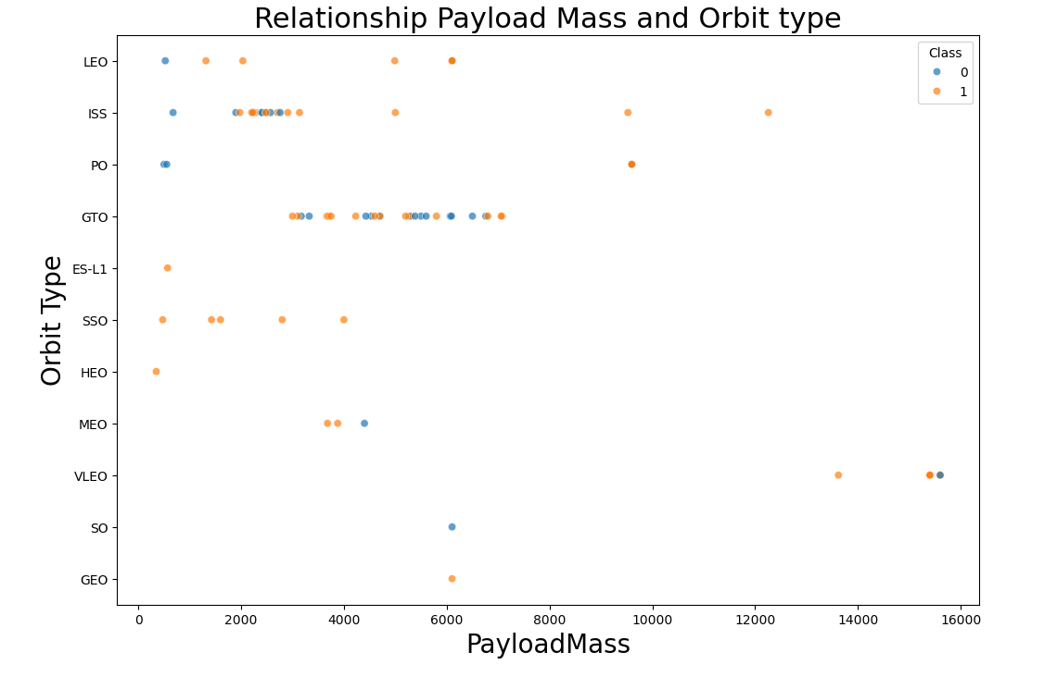
Payload vs. Orbit Type
With heavy payloads the successful landing or positive landing rate are more for Polar, LEO and ISS.
However, for GTO, it's difficult to distinguish between successful and unsuccessful landings as both outcomes are present.

Slide 24
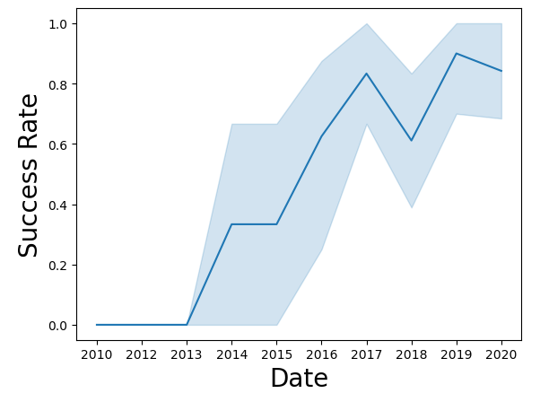
Launch Success Yearly Trend
We can observe that the sucess rate since 2013 kept increasing till 2020

Slide 25
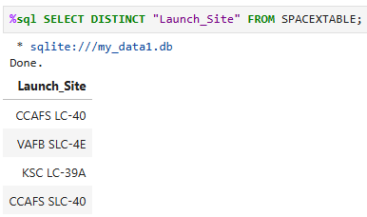
All Launch Site Names
Key word DISTINCT was used to show only unique launch sites from the SpaceX data.

Slide 26
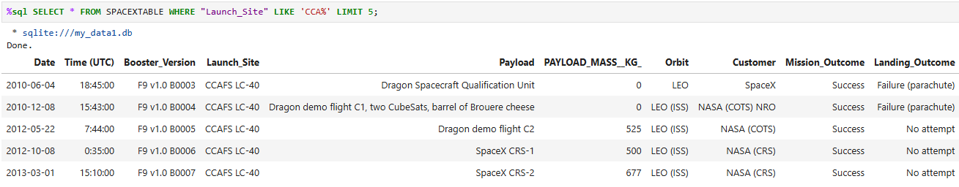
Launch Site Names Begin with 'CCA'
Display 5 records where launch sites begin with `CCA`

Slide 27
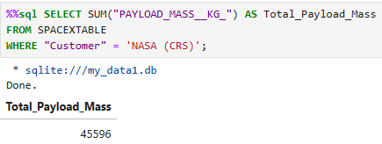
Total Payload Mass
Calculate the total payload carried by boosters from NASA

Slide 28
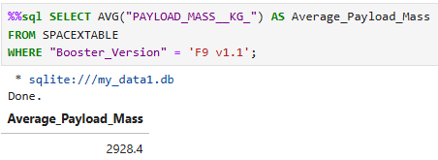
Average Payload Mass by F9 v1.1
Calculate the average payload mass carried by booster version F9 v1.1

Slide 29
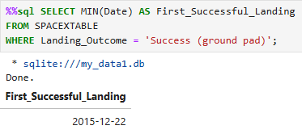
First Successful Ground Landing Date
Find the dates of the first successful landing outcome on ground pad

Slide 30
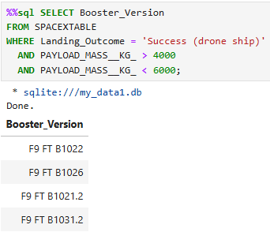
Successful Drone Ship Landing with Payload between 4000 and 6000
List the names of boosters which have successfully landed on drone ship and had payload mass greater than 4000 but less than 6000 kg

Slide 31
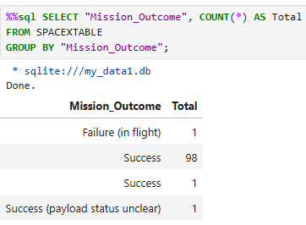
Total Number of Successful and Failure Mission Outcomes
Calculate the total number of successful and failure mission outcomes

Slide 32
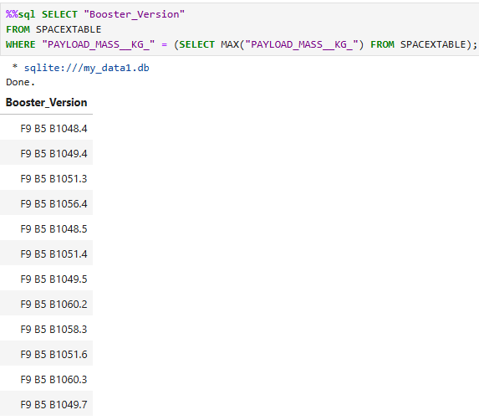
Boosters Carried Maximum Payload
List the names of the booster which have carried the maximum payload mass

Slide 33
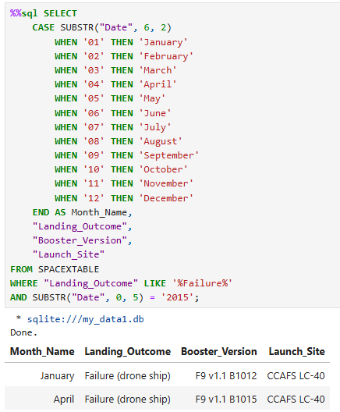
2015 Launch Records
List the failed landing outcomes in drone ship, their booster versions, and launch site names for in year 2015

Slide 34
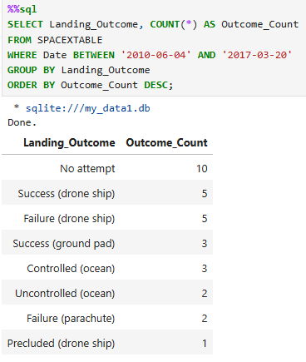
Rank Landing Outcomes Between 2010-06-04 and 2017-03-20
Rank the count of landing outcomes (such as Failure (drone ship) or Success (ground pad)) between the date 2010-06-04 and 2017-03-20, in descending order

Slide 35

Section 3

Slide 36
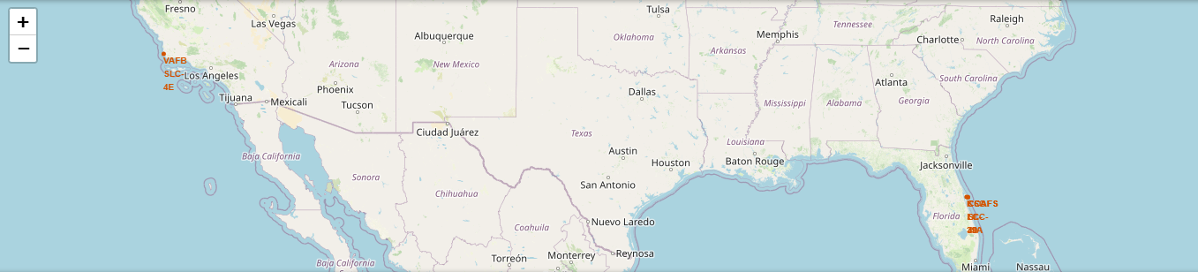
Launch Sites on a Map
SpaceX launch sites are located on the coast of USA

Slide 37
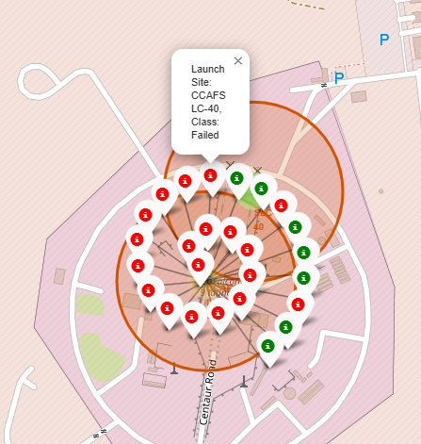
Success/Failed Launches for Each Site
Adding the launch outcomes for each site, and see which sites have high success rates.
Should be able to easily identify which launch sites have relatively high success rates

Slide 38
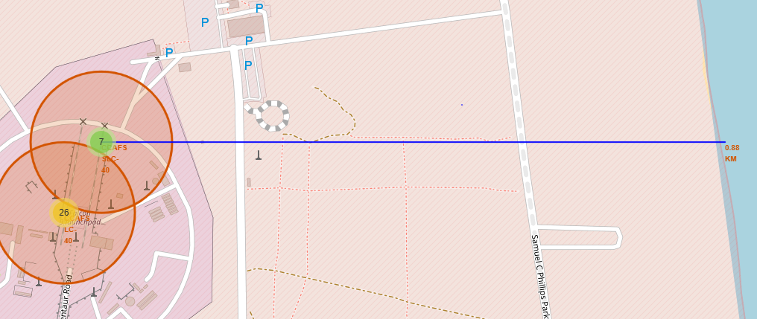
Calculate the Distances
Distances between a launch site to proximities such as railway, highway, coastline, with distance calculated and displayed
Distance calculated and displayed

Slide 39

Section 4

Slide 40
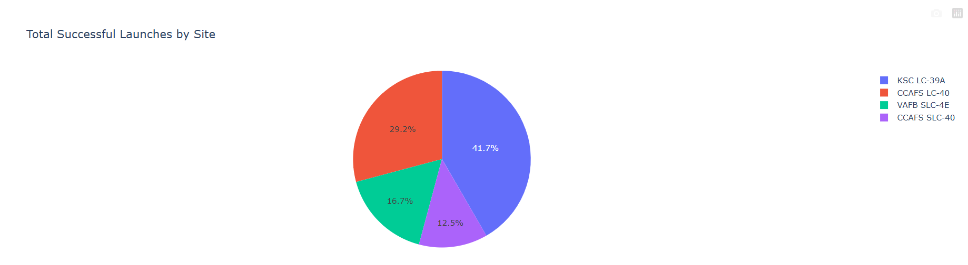
Total Successful Launches by Site
KSC LC-39A has the most successful launches with 41.7%

Slide 41
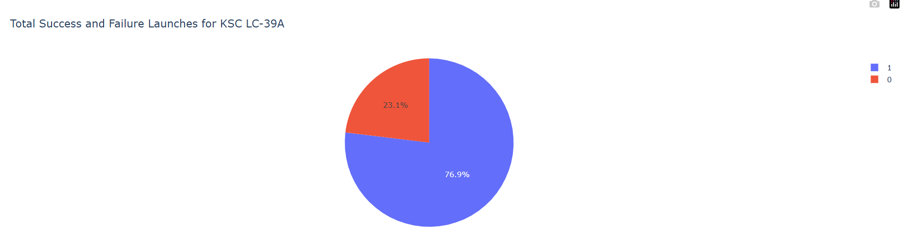
Launch Site with Hiest Launch Success Ratio
This pie chart shows the success and failure launches for KCS LC-39A

Slide 42
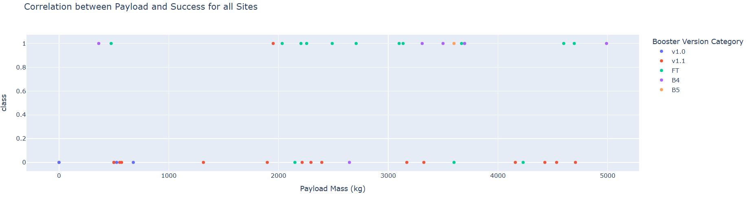
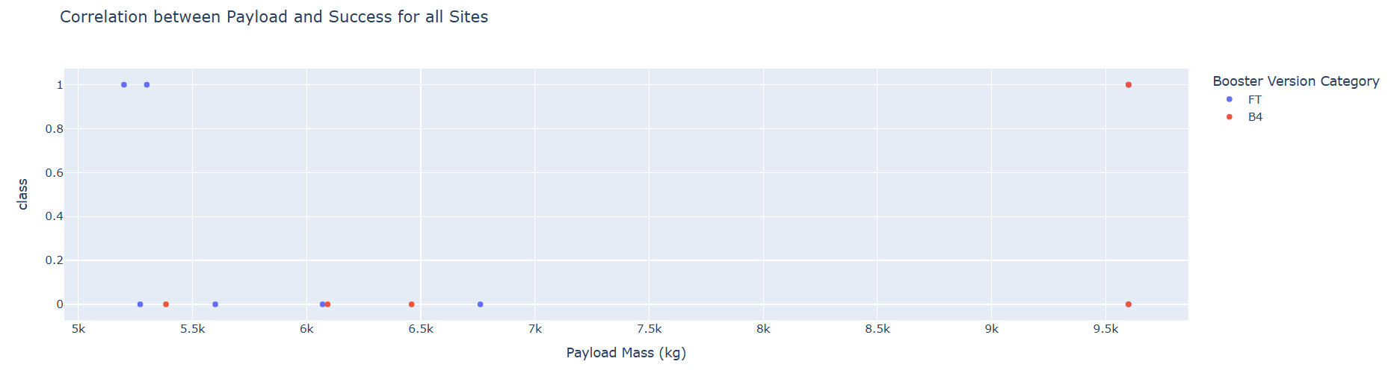
Payload vs Launch Outcome
Payload vs. Launch Outcome scatter plot for all sites with
Success rates for low weighted payloads (FIG 1) are higher than heavy weighted payloads (FIG 2).
FIG 1
FIG 2

Slide 43

Section 5

Slide 44
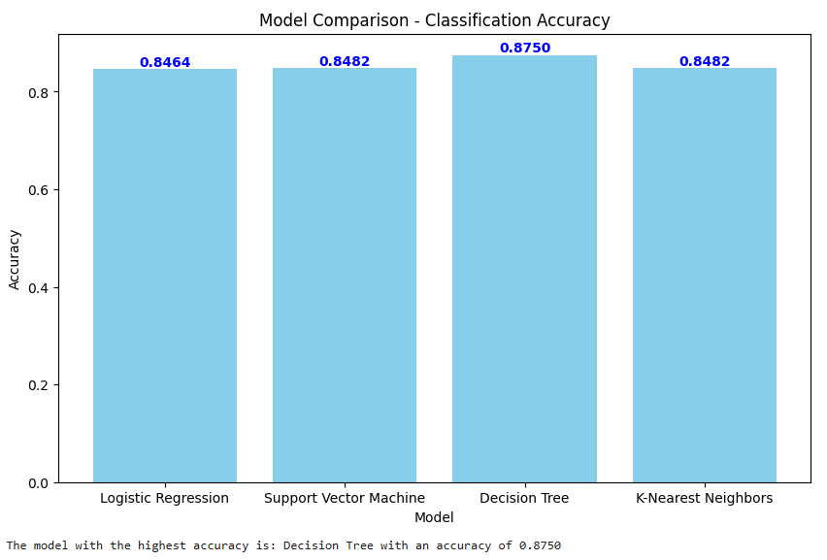
Classification Accuracy
The decision tree classifier is the model with the highest accuracy

Slide 45
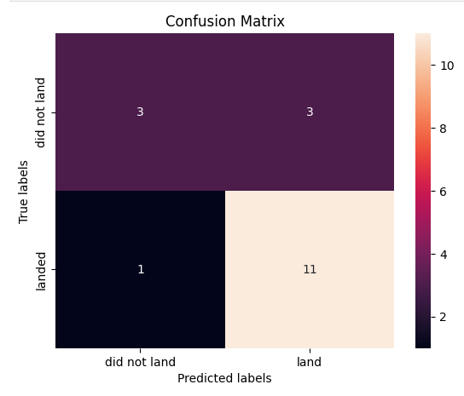
Confusion Matrix
This confusion matrix indicates that the model has a high accuracy rate for the "landed" class and some confusion in the "did not land" class.

Slide 46
Conclusions
The higher the number of flights at a launch site, the greater the success rate at that site.
The launch success rate began increasing in 2013 and continued to rise until 2020.
The orbits ES L1, GEO, HEO and SSO had the highest success rates.
KSC LC-39A had the most successful launches among all sites.
The Decision Tree classifier is the most suitable machine learning algorithm for this task.

Slide 47


